Slide 1


https://valueflo.ws
hREA
https://hrea.io

Slide 2
hREA
REA (Resources Events Agents)
is an ontology developed in academia starting in 1980
re-thought double entry accounting to create a reality-based economic model
Valueflows
defines an implementation-oriented REA-based standard vocabulary
works for organizations but is focused on coordinating networked economies
hREA
implements the Valueflows model in the peer-to-peer Holochain environment
is a backend with a graphql api that will support many economic use cases

Slide 3
hREA
Our focus today
We will be going over the Valueflows data model and its potential uses.
This is primarily for developers who are or may want to implement hREA-based economic applications.
It will also be applicable to others who are interested in the Valueflows concepts and model, irrespective of the technical ecosystem.

Slide 4
hREA
What makes this different than conventional accounting and enterprise resource planning?
The model is designed to support:
coordination of economic activity both inside and between organizations, an enterprise is not assumed;
reciprocity with or without money, money is not assumed;
ecological agents can be part of the network; externalities can be resources.
In other words, the model will support conventional businesses, and also “next economy” experiments for more fairness and sustainability.

Slide 5
hREA
Resources – Events - Agents
Agents are individual persons or organizations or ecological agents, who perform Economic Events affecting Economic Resources.
An Economic Event can take actions like produce, modify, consume, or use Economic Resources, or transfer them from one Agent to another, or transport them from one location to another.
Economic Resources would typically be useful goods and services, but could also be money, credits, energy, knowledge, designs, skills, CO2, toxins, water, or almost anything else that some Agents can agree should be accounted for in their economic networks.

Slide 6
hREA
Input – Process - Output
The IPO pattern is used to enhance the ability of REA to represent complex flows of value. The flows are IPOs...
...Input-Process-Output resource chains, where one Economic Resource is the output of one Process and then becomes an input to another Process, thus creating a flow. The Agents involved in each Process in the chain need to coordinate with the previous and next Processes about the quantity, quality, and timing of resource flows between them.

Slide 7
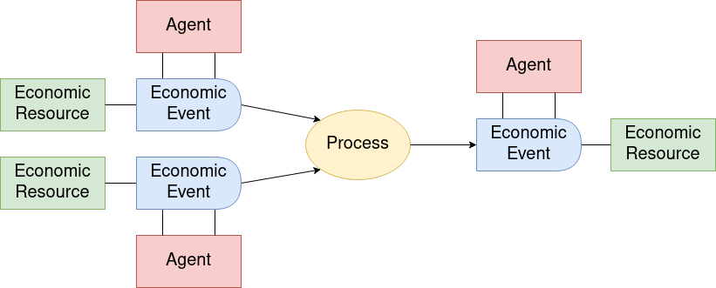
hREA
Putting them together
In general, how they fit together: Agents perform Economic Events that provide Inputs to Processes and take Outputs from Processes and move Resources from one Process to another. This forms a directed graph of resource flows.

Slide 8
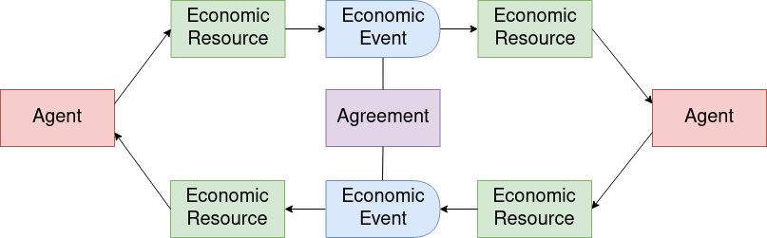
hREA
Transfers and Exchanges
Some flows do not involve processing, i.e. there is no transformation of Economic Resources. These flows simply transfer Economic Resources between Agents or move them between locations. One common example is an exchange of one Economic Resource for another Economic Resource between two Agents, as below, with two reciprocal flows based on an Agreement.

Slide 9

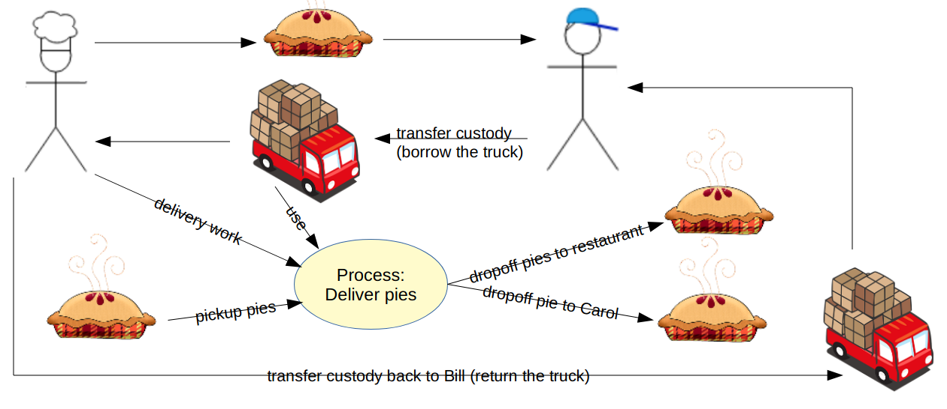
hREA
Flows...
Resource flows occur when an output of one process becomes (or can become) the input or another process. Process flows can also integrate with transfer or exchange flows in the same manner.

Slide 10

hREA
The Knowledge level represents classification, policies, procedures, rules and patterns. This is where each network or community can configure the core concepts to fit their needs.
The Plan level represents offers and requests, schedules and promises. This level can also support budgeting or other pre-operational general planning.
The Observation level represents what really happened. This is used for coordinating operations, accounting, other reporting and analysis.
Levels of the model

Slide 11
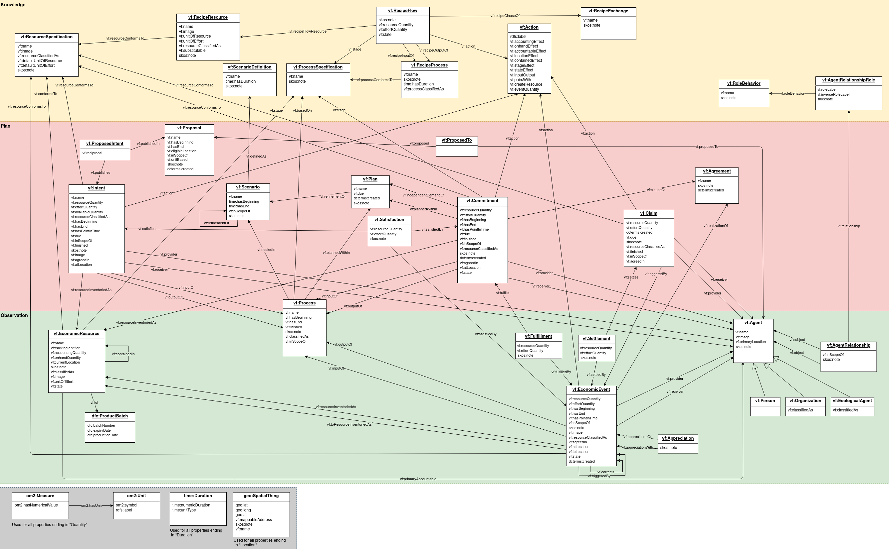
hREA
The whole model… but it’s not as scary as it looks
https://valueflo.ws/specification/uml/

Slide 12
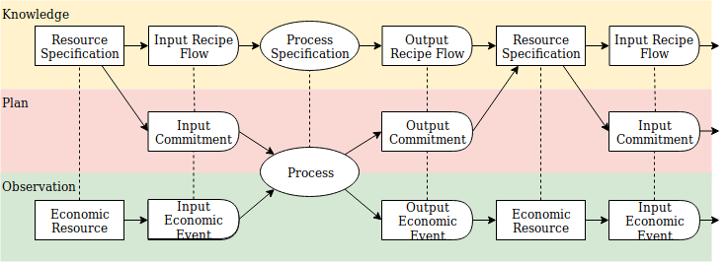
hREA
Some simple flows in motion...

Slide 13
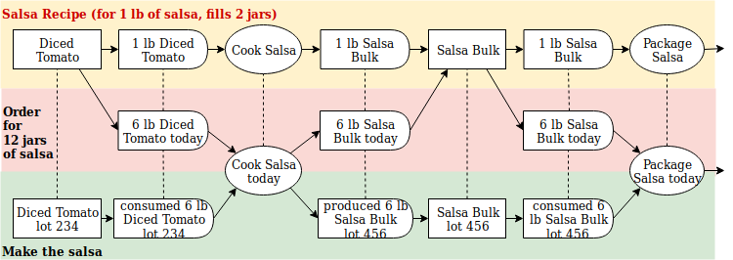
hREA
… and with example data
… each level implements roughly the same REA-IPO patterns

Slide 14

hREA
Analytical data
The same REA-IPO patterns also work for different granularities of data.

Slide 15

hREA
Networks of networks
When networks are distributed horizontally, communicating with Valueflows and standard protocols, you can:
track and trace for health or for a “digital passport” or for rewarding contributions
plan and coordinate at a supply chain or community or regional or global level

Slide 16
hREA
More detail about resource flows
The following slides give another level of detail about some aspects of the Valueflows model which can be confusing.

Slide 17
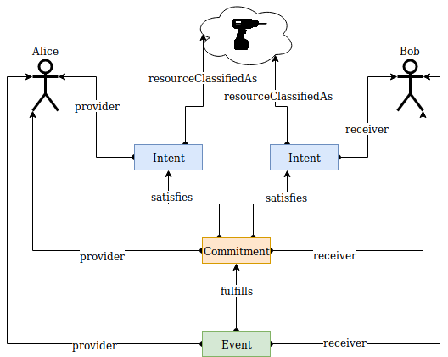
hREA
Intents, Commitments, Economic Events
Intents describe potential future events which have not been agreed to by other agents, such as offers and requests. Intents and reciprocal Intents can be bundled in an Proposal.
Commitments describe potential future events which the involved agents have agreed to pursue. Commitments can also be thought of as plans for Economic Events. Commitments can be bundled in an Agreement.
Economic Events describe past activity, something observed or done. They can also be bundled in an Agreement if there are no Commitments.

Slide 18
hREA
Economic Resources vs Resource Specifications
An Economic Resource is observable. Its Resource Specification defines what type of thing the economic resource is.
Resources can be:
Inventoried: You want to keep track of its changes in quantity, and how many you have right now, possibly its location, etc.
Not inventoried: You could keep track of it, but it isn't worth it. This usually happens for quantities of small or hard to measure items that are obtained in bulk.
Not applicable: This is for types of work, services, and other types where it just doesn't make sense.
If a resource is not inventoried, it is generally not instantiated in the software, but defined using a Resource Specification. Also, in planning, the Resource Specification is generally used in flows, unless the Economic Resource is unique.
Substitutability: This defines if any Economic Resources of that Resource Specification can be freely substituted for any other Economic Resource of that same Resource Specification when used, consumed, traded, etc.

Slide 19
hREA
Resource Identification
Here are three different kinds of Economic Resources from the viewpoint of identification:
serialized resources, where each individual instance has a unique identifier,
lot-controlled resources, where each lot or batch has a unique identifier, but the lot or batch may contain many individual instances, and
count or volume or stock resources, where individual instances are indistinguishable, or in the case of fluids, only exist on a molecular level.
Stage is used when the same identified resource passes through multiple processes in its lifetime, and that information is needed by the next process to determine which resources can be valid inputs. In this case, the stage is part of the identifier.

Slide 20
hREA
Economic Resources and Economic Events
One of the hardest things to internalize about Economic Resource is that in the majority of cases, we should think of them as stock resources. So if there is a large bin of apples, and a bushel is removed to give to another agent, the apple resource remains the same, only its quantity is decremented. The large bin of apples is an Economic Resource, but the bushel of apples is not, it is only a quantity on an Economic Event. There is another Economic Resource of apples on the other end of this event, which will then be incremented by a bushel. So thinking of the actual apples you can touch as an Economic Resource is wrong.
All economic information in an Economic Resource must be put there by an Economic Event. Non-economic information (note, image, etc.) can be updated on the Economic Resource directly.
How an Economic Event affects an Economic Resource is determined by its Action...

Slide 21
hREA
Actions
All flows (Economic Event, Commitment, Intent, Claim, Recipe Flow) use an action property to designate what the flow is doing and how it will affect or has affected an economic resource (or not). Here are the most used actions.
Transformation Processes
No Process
consume -
use
cite
work
transfer - +
transfer all rights - +
transfer custody
move
produce +
deliver service
Modification Processes
When there is no process involved, the Economic Event affects two resources, one on the provider side and one on the receiver side.
accept
modify
Transportation Processes
pickup
dropoff

Slide 22
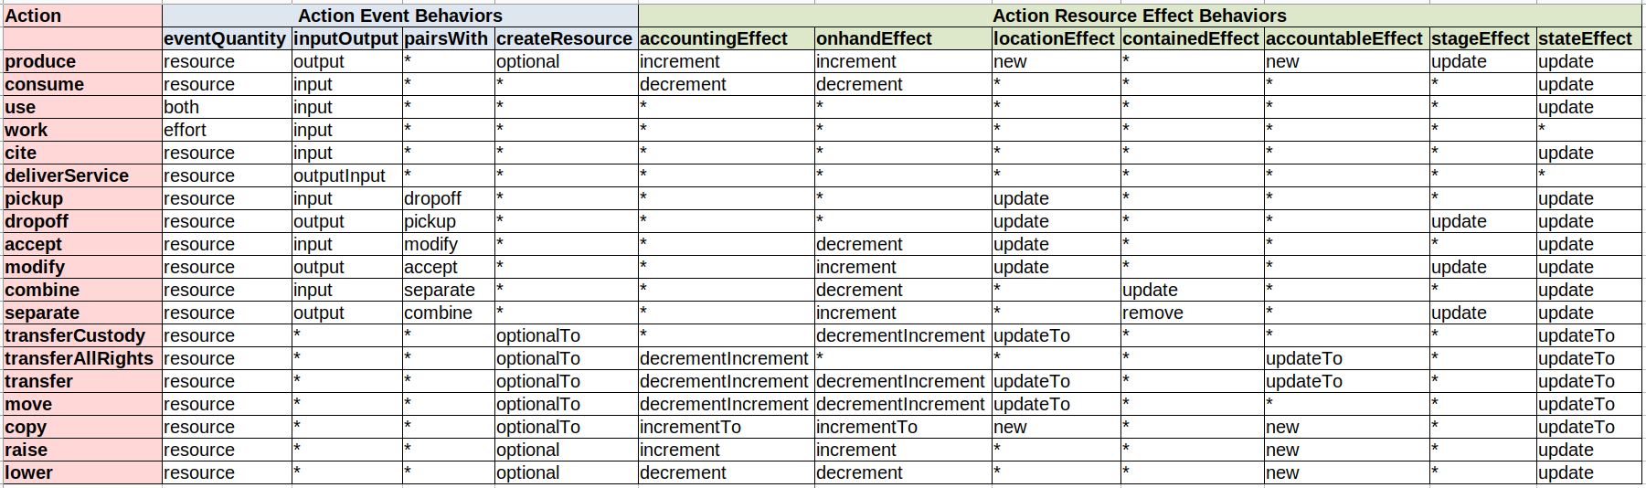
hREA
Actions
Actions have behavior definitions, so they can be used in a data-driven manner, both on a UI, and when affecting Economic Resources.

Slide 23
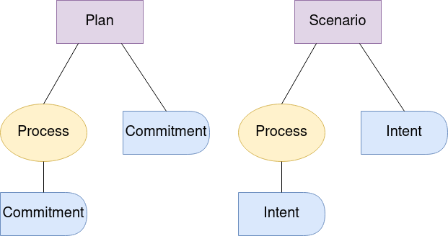
hREA
Plans and Scenarios
Plans bundle processes and non-process commitments. They are operational, meaning done at the level of detail needed to plan and do.
Scenarios have a similar structure, but are used for pre-operational planning (budgets, etc.) and for higher level analytical needs.

Slide 24
hREA
Thank you!
https://valueflo.ws
https://hrea.io

